Slide 1
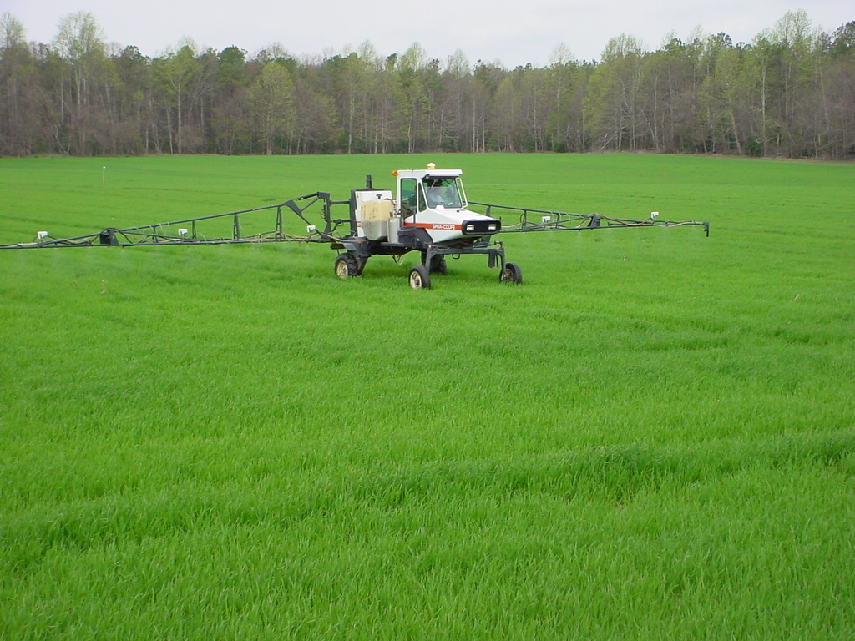

Implementing the Mid-Atlantic
Corn and Wheat Algorithms
for GreenSeeker
Wade Thomason, VT
Steve Phillips, IPNI
Paul Davis, VCE retired
Josh McGrath, U of KY

Slide 2

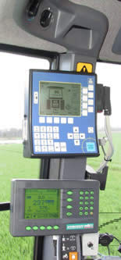

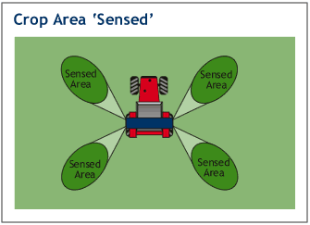
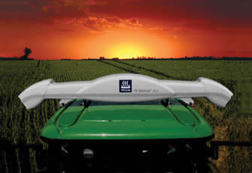
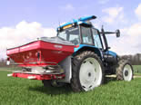
In-Season Remote Sensing
Satellite
Aerial photography
Ground-based Sensing

Slide 3
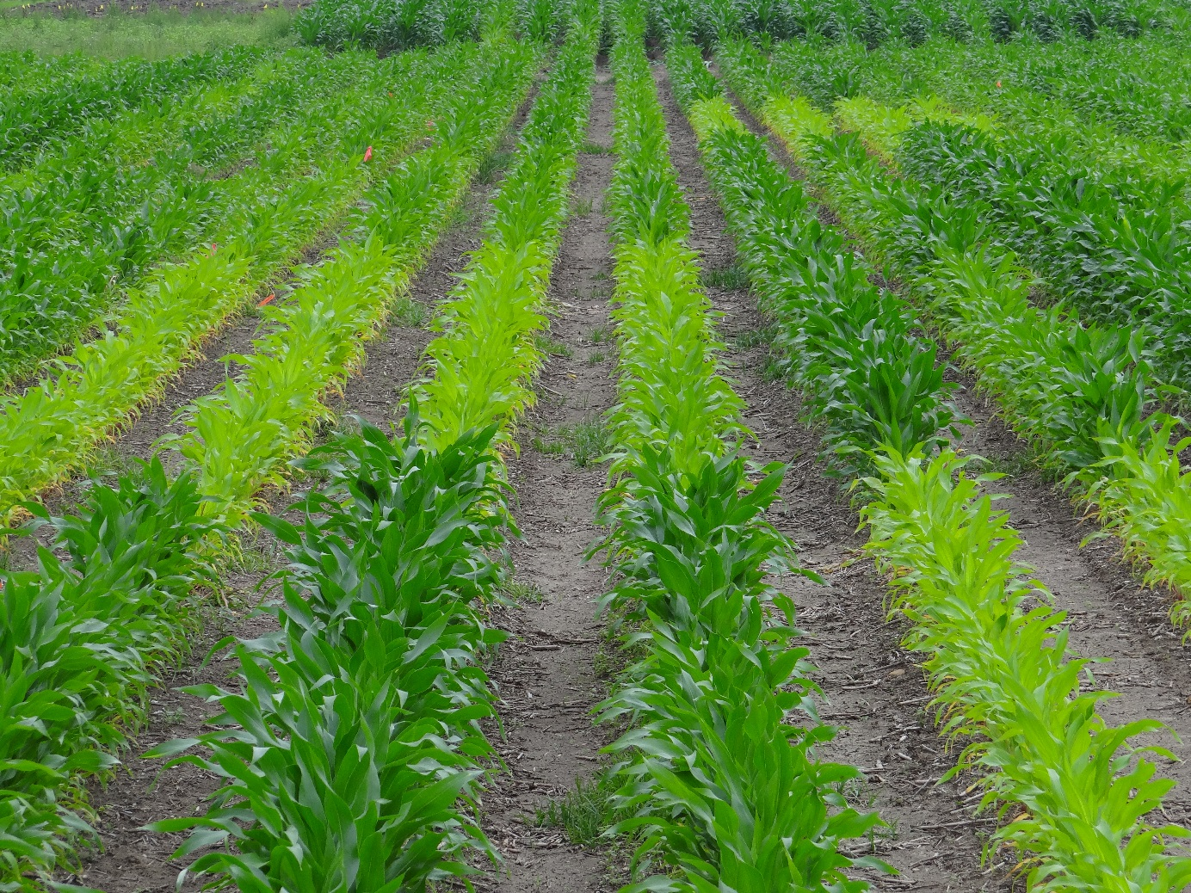
In-Season Remote Sensing of Crop N Status

Slide 4
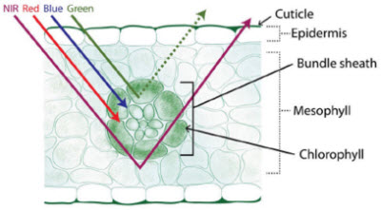
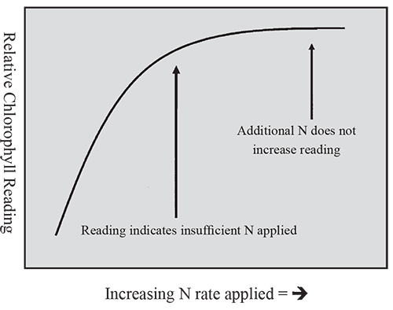
In-Season Remote Sensing of N Crop N Status

Slide 5
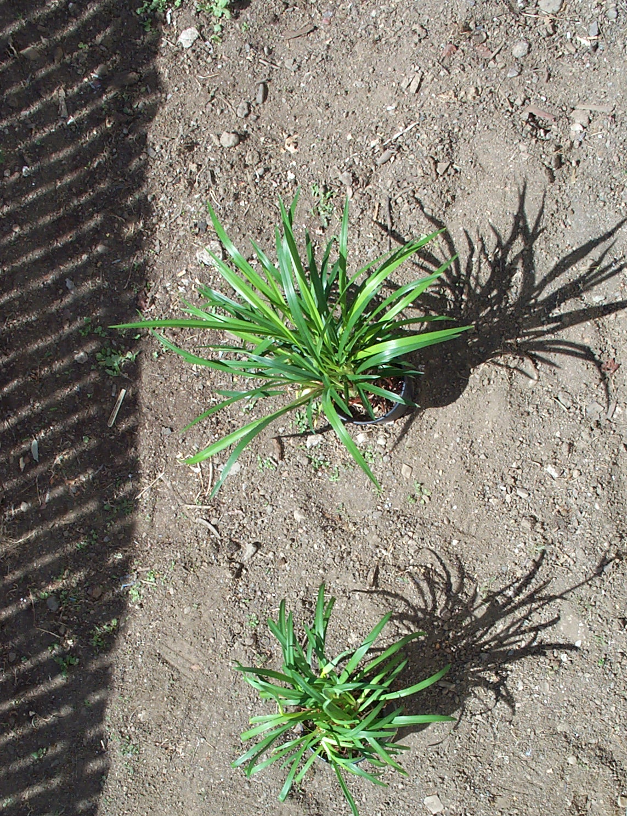

What the Sensor “Sees”
The vigor of the leaves and
the ratio of plant to soil
affect NDVI values
The vigor of the leaves and
the ratio of plant to soil
affect NDVI values

Slide 6
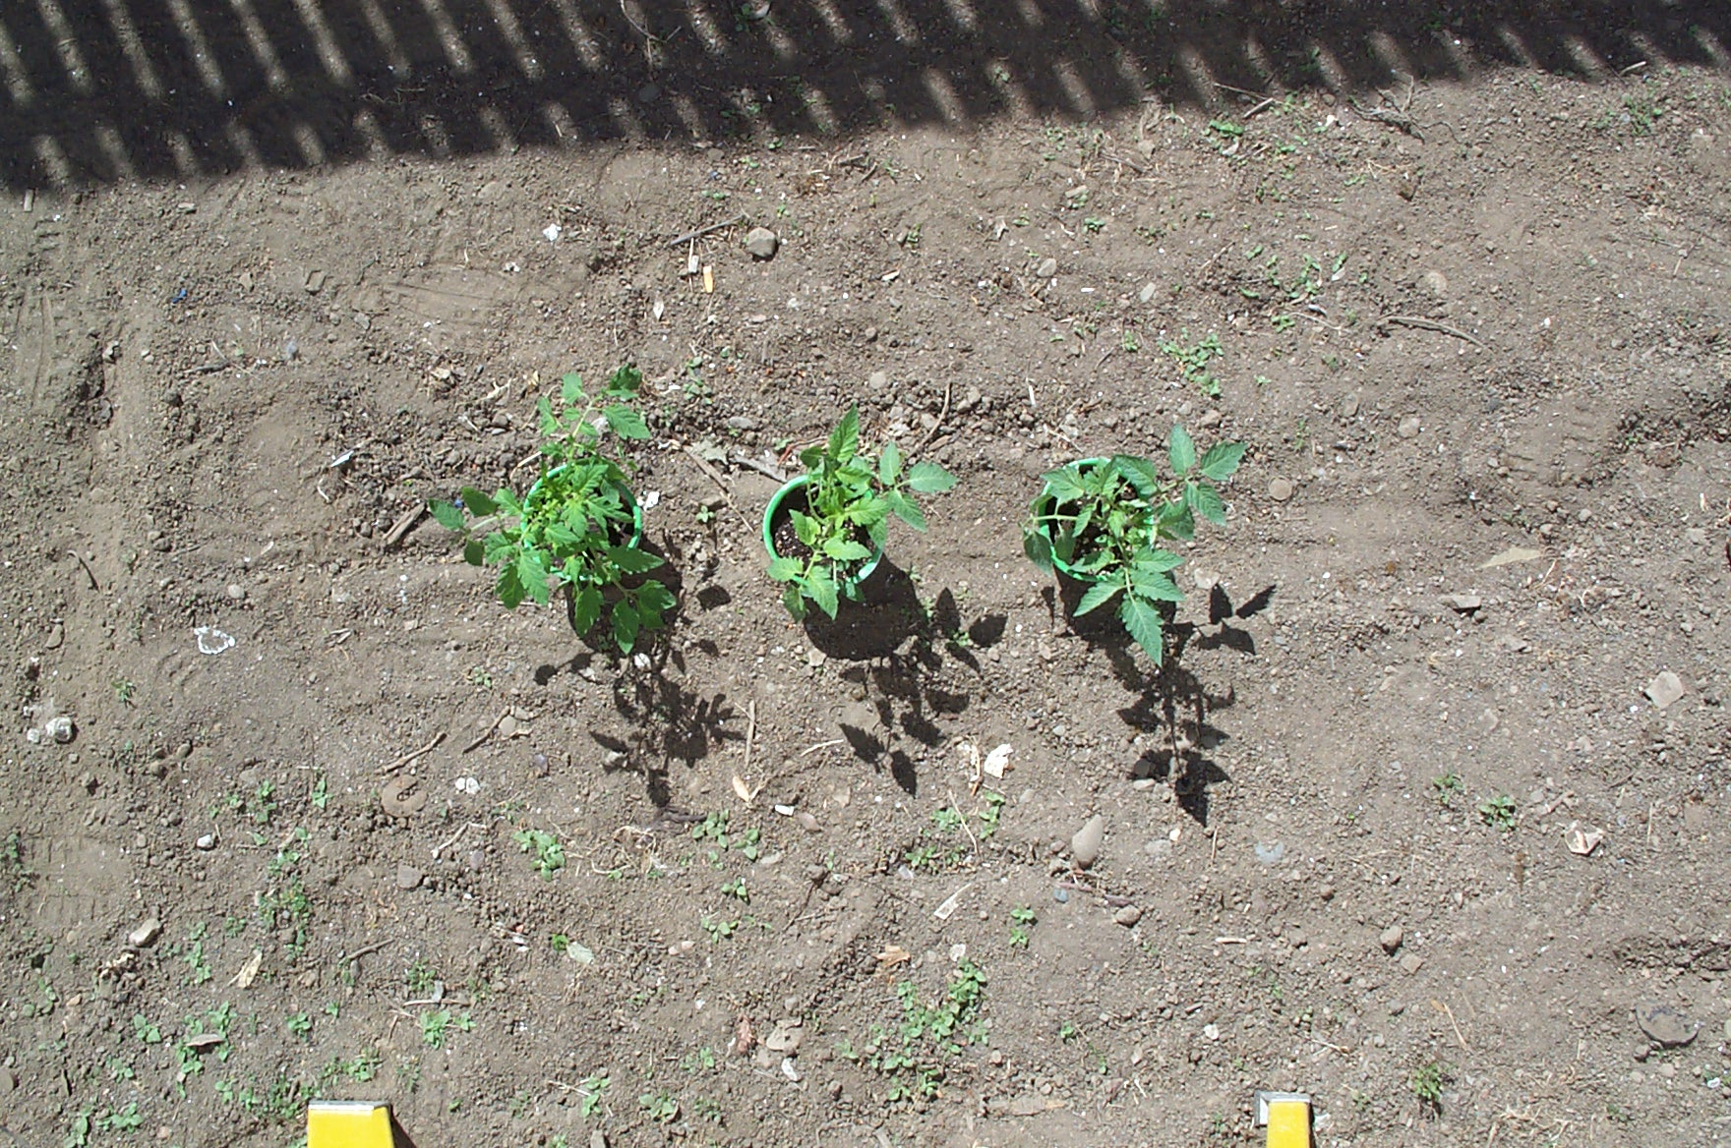
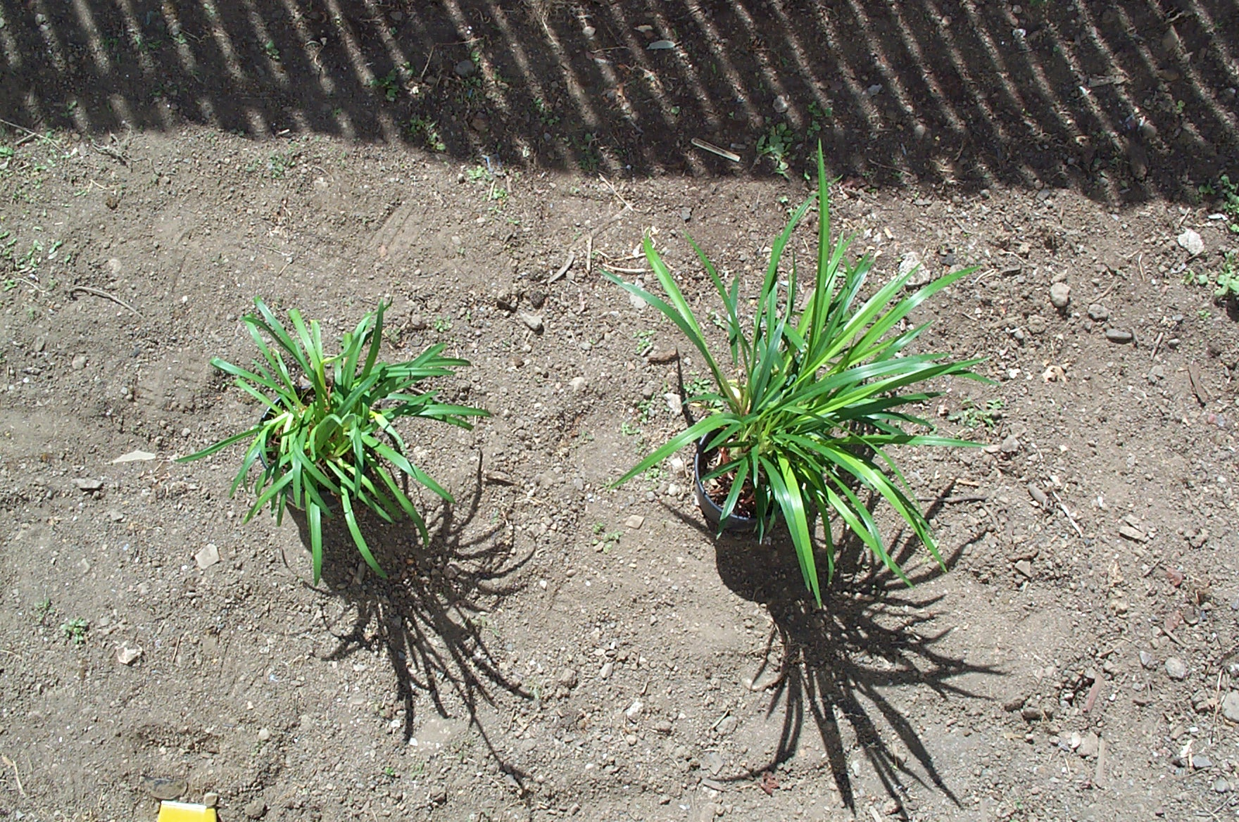
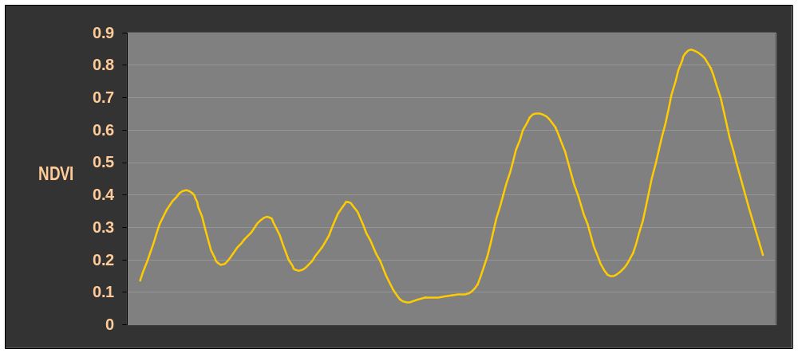
Note that the biomass of each plant is observable in NDVI value

Slide 7
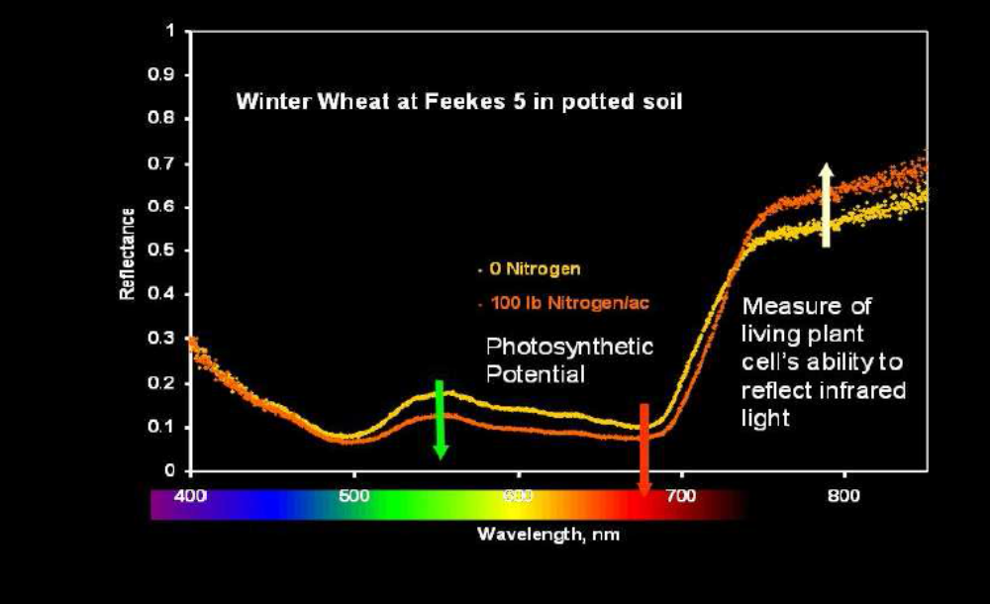
Optical Sensor Values
NDVI
  Regardless of sensor is essentially a measure of biomass.
  NDVI = (NIR-VIS)/(NIR+VIS)

Slide 8
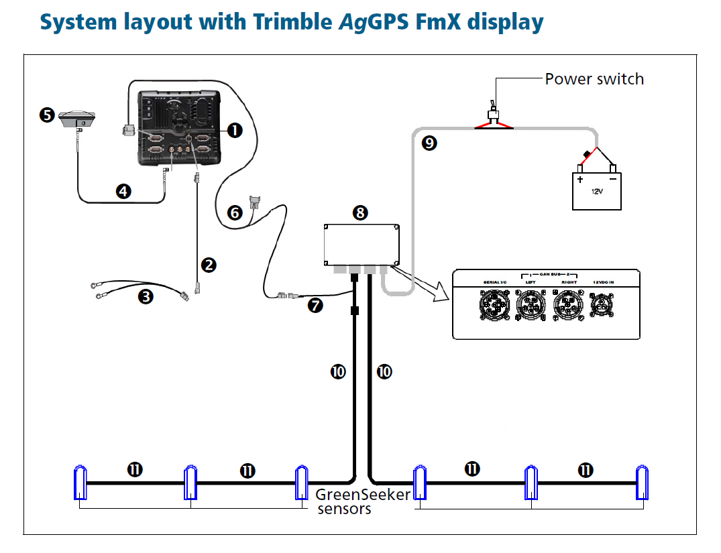
GreenSeeker System

Slide 9
Algorithm Development

Slide 10
Algorithm Development

Slide 11
Response Index
N uptake in N-Rich area
N uptake in area to be Fertilized
= RI
Add in-season N
60 lb N
40 lb N
= 1.5
No in-season N

Slide 12

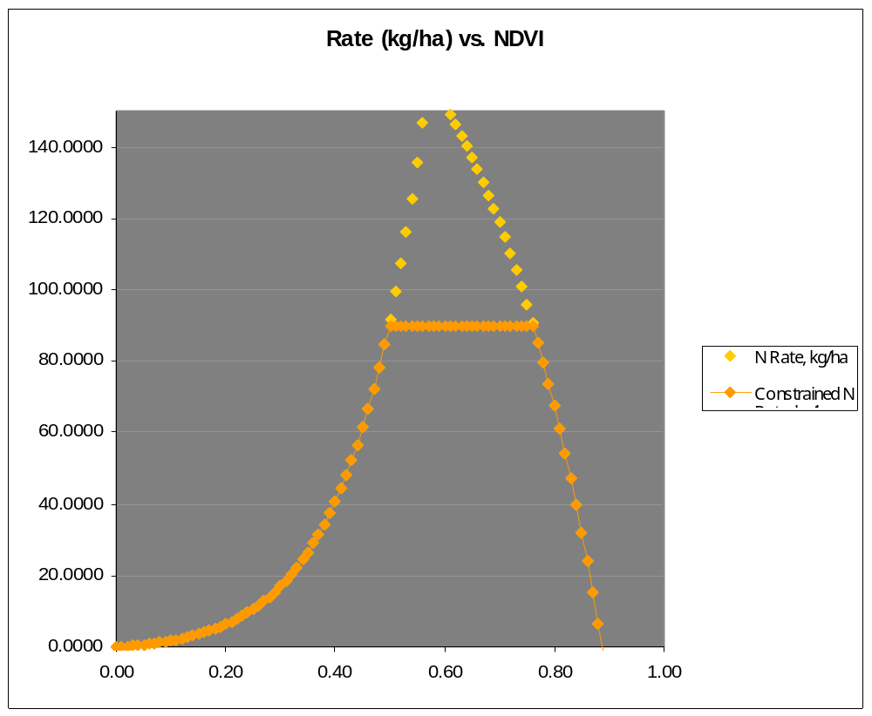


Wheat N Rate Algorithm

Slide 13
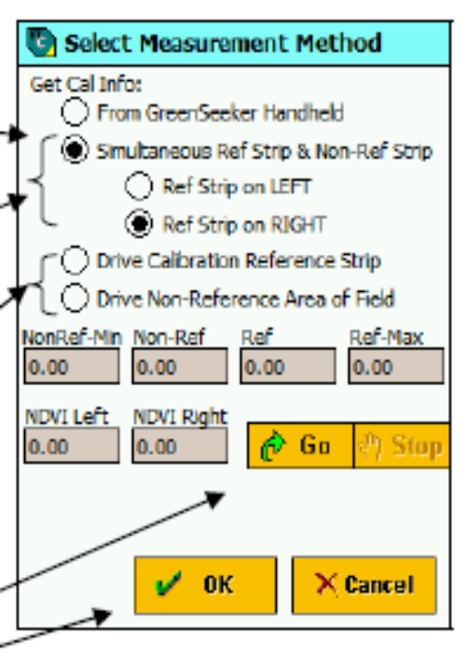
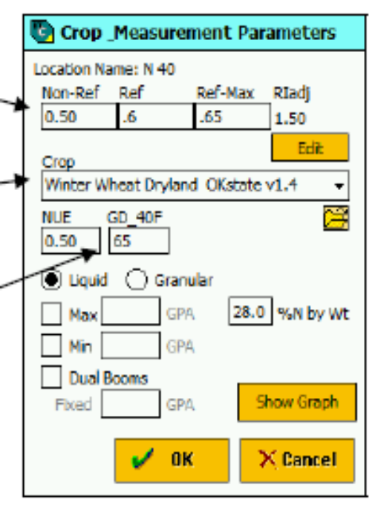
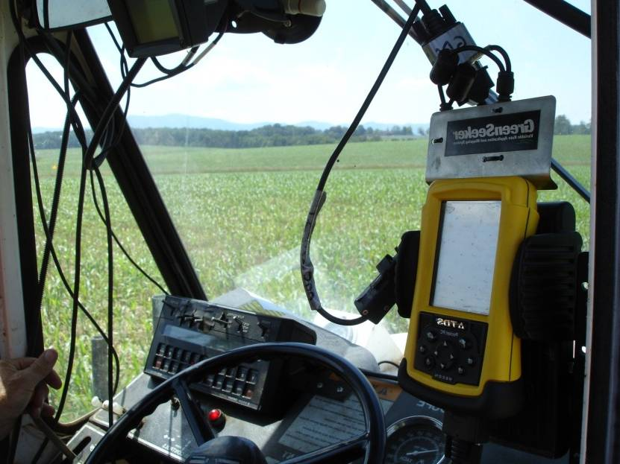
Entering Required Information

Slide 14
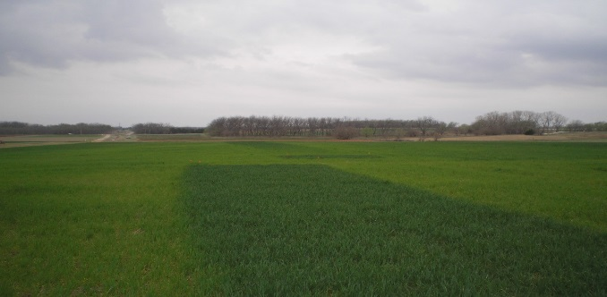
Virginia Wheat
High Reference
  At GS 25 (greenup)
Low Reference
  Only preplant N, no winter/greenup application
Days from planting to current
N rate applied at greenup
Maximum Yield
Maximum N Rate
NUE

Slide 15
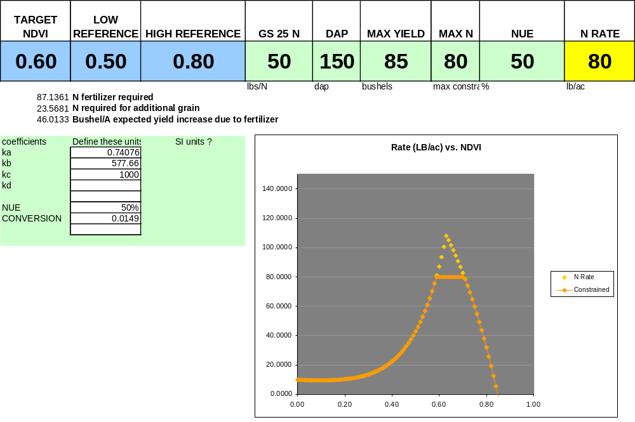
VIRGINIA APPROACH - Wheat

Slide 16
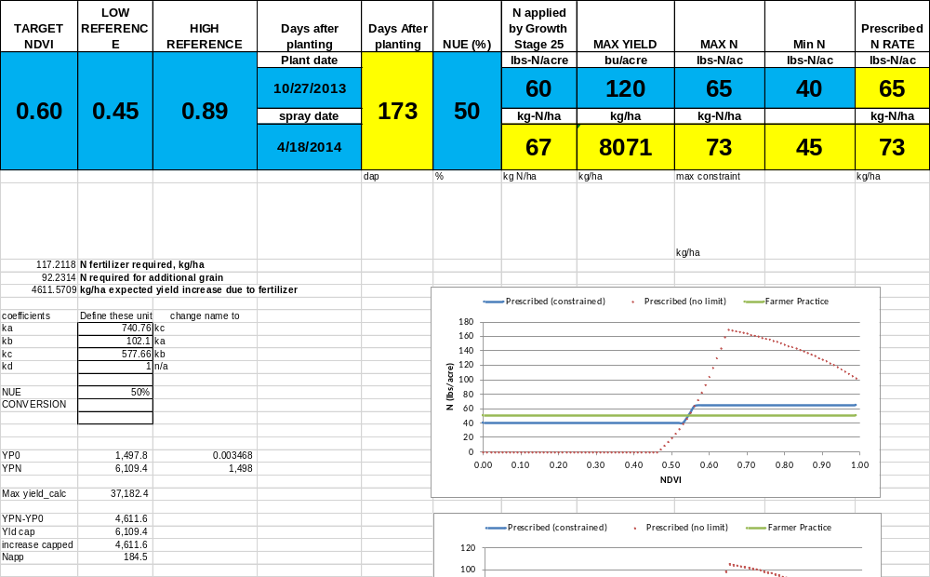
Virginia Wheat Algorithm Inputs

Slide 17
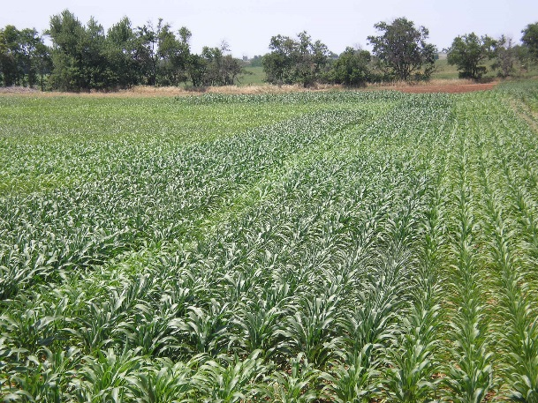
N-rich strip
  Trimble
    300 ft long
    Representative area of the field (not high or low)
    Rate equal to the highest rate needed by the crop for the season?
    May require a decreased
    pre-plant N rate
    Mark it!

Slide 18
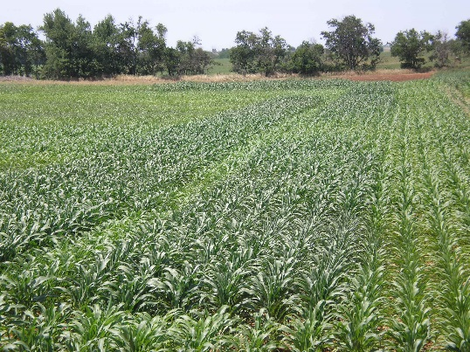
N-rich strip
  Trimble
    At appropriate time (Zakoks 30-32) measure NDVI from reference
    32 to 48 “ above canopy
    Full boom, ½ boom, handheld, manual entry

Slide 19
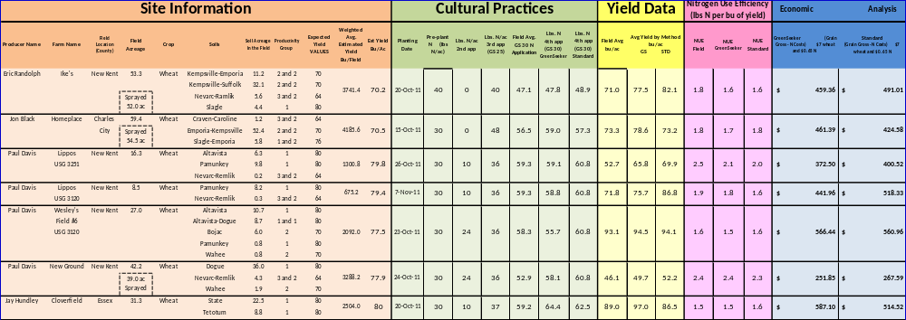

Slide 20
Wheat Results – Coastal Plain
 |  | GreenSeeker | Standard | GreenSeeker | Standard
Year | Acres | N rate, lb/ac |  | Yield, bu/ac
2012 | 804 | 58.1 | 58.4 | 77.3 | 76.6
2013 | 1008 | 53 | 59 | 74.6 | 75.5
Avg Yield by N Application Method GS STD
86.75 | 74.16

Slide 21
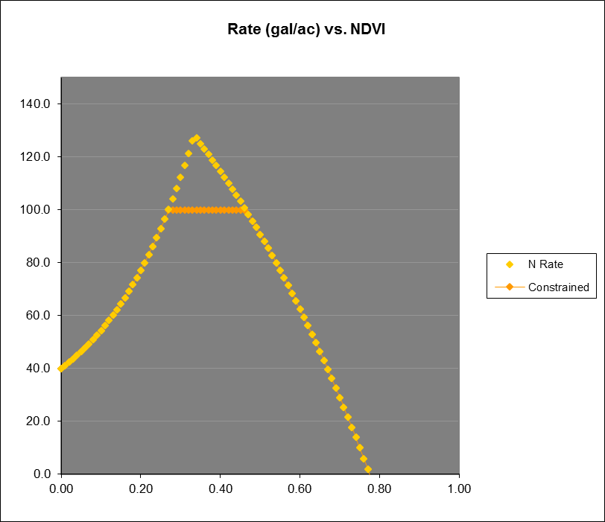
Effect of RI on N Rate
High | Low | RI
0.8 | 0.4 | 2.0
0.8 | 0.45 | 1.8
0.8 | 0.5 | 1.6
0.8 | 0.55 | 1.5
0.8 | 0.6 | 1.3
0.8 | 0.75 | 1.1

Slide 22
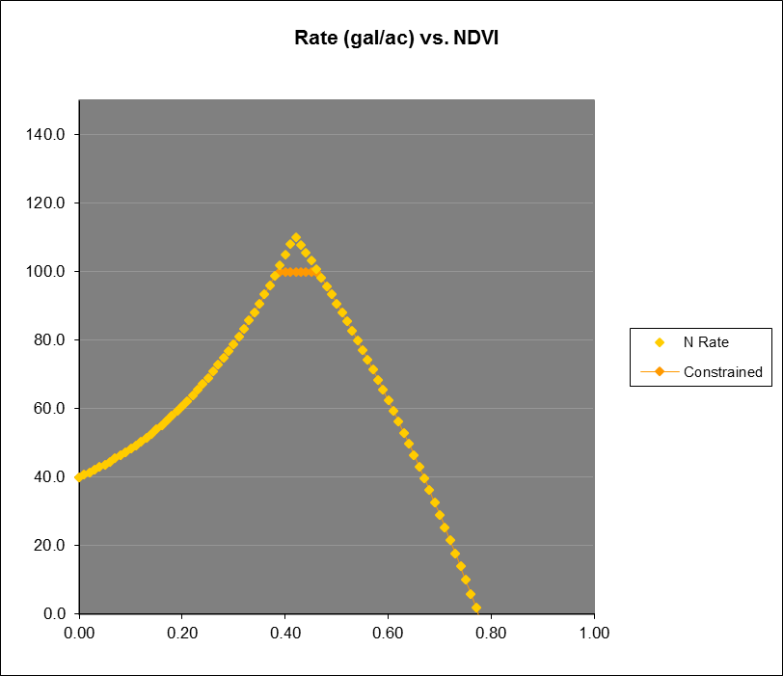
Effect of RI on N Rate
High | Low | RI
0.8 | 0.4 | 2.0
0.8 | 0.45 | 1.8
0.8 | 0.5 | 1.6
0.8 | 0.55 | 1.5
0.8 | 0.6 | 1.3
0.8 | 0.75 | 1.1

Slide 23
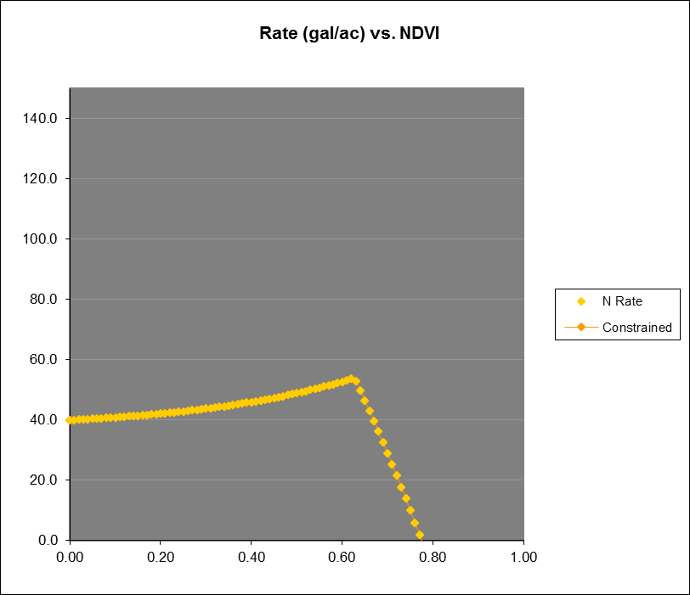
Effect of RI on N Rate
High | Low | RI
0.8 | 0.4 | 2.0
0.8 | 0.45 | 1.8
0.8 | 0.5 | 1.6
0.8 | 0.55 | 1.5
0.8 | 0.6 | 1.3
0.8 | 0.75 | 1.1

Slide 24
As the High and Low References move together the response to N decreases.
RI is typically lower in the early season. Less N response/stress

Slide 25
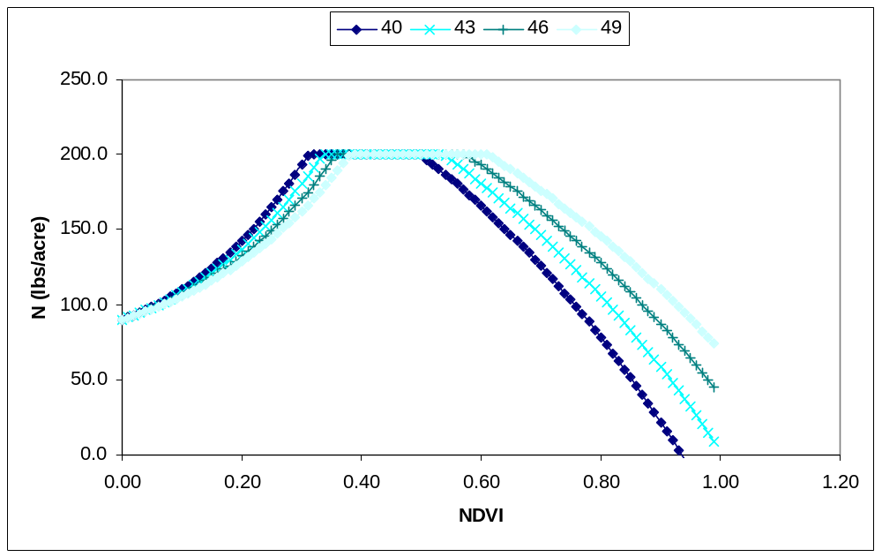
Effect of DFP on N rate
Parameters
Low Reference | 0.35
High Reference | 0.75
N Preplant | 10
Yield Goal | 210
Max N | 200
NUE | 50%
As DFP increases at a given RI the response to N decreases for lower NDVI
Higher NDVI’s need more N to achieve max yield

Slide 26
General “Tips” on the VA Algorithms
What if I don’t have a high N reference?
  Use a “virtual” reference.
  Drive across the crop
  Note the highest NDVI value (sustained)
  Multiply by 0.9
  Enter that as “High” REF
  UNDERSTAND that what you just did was ASSUME that that difference is due to N

Slide 27
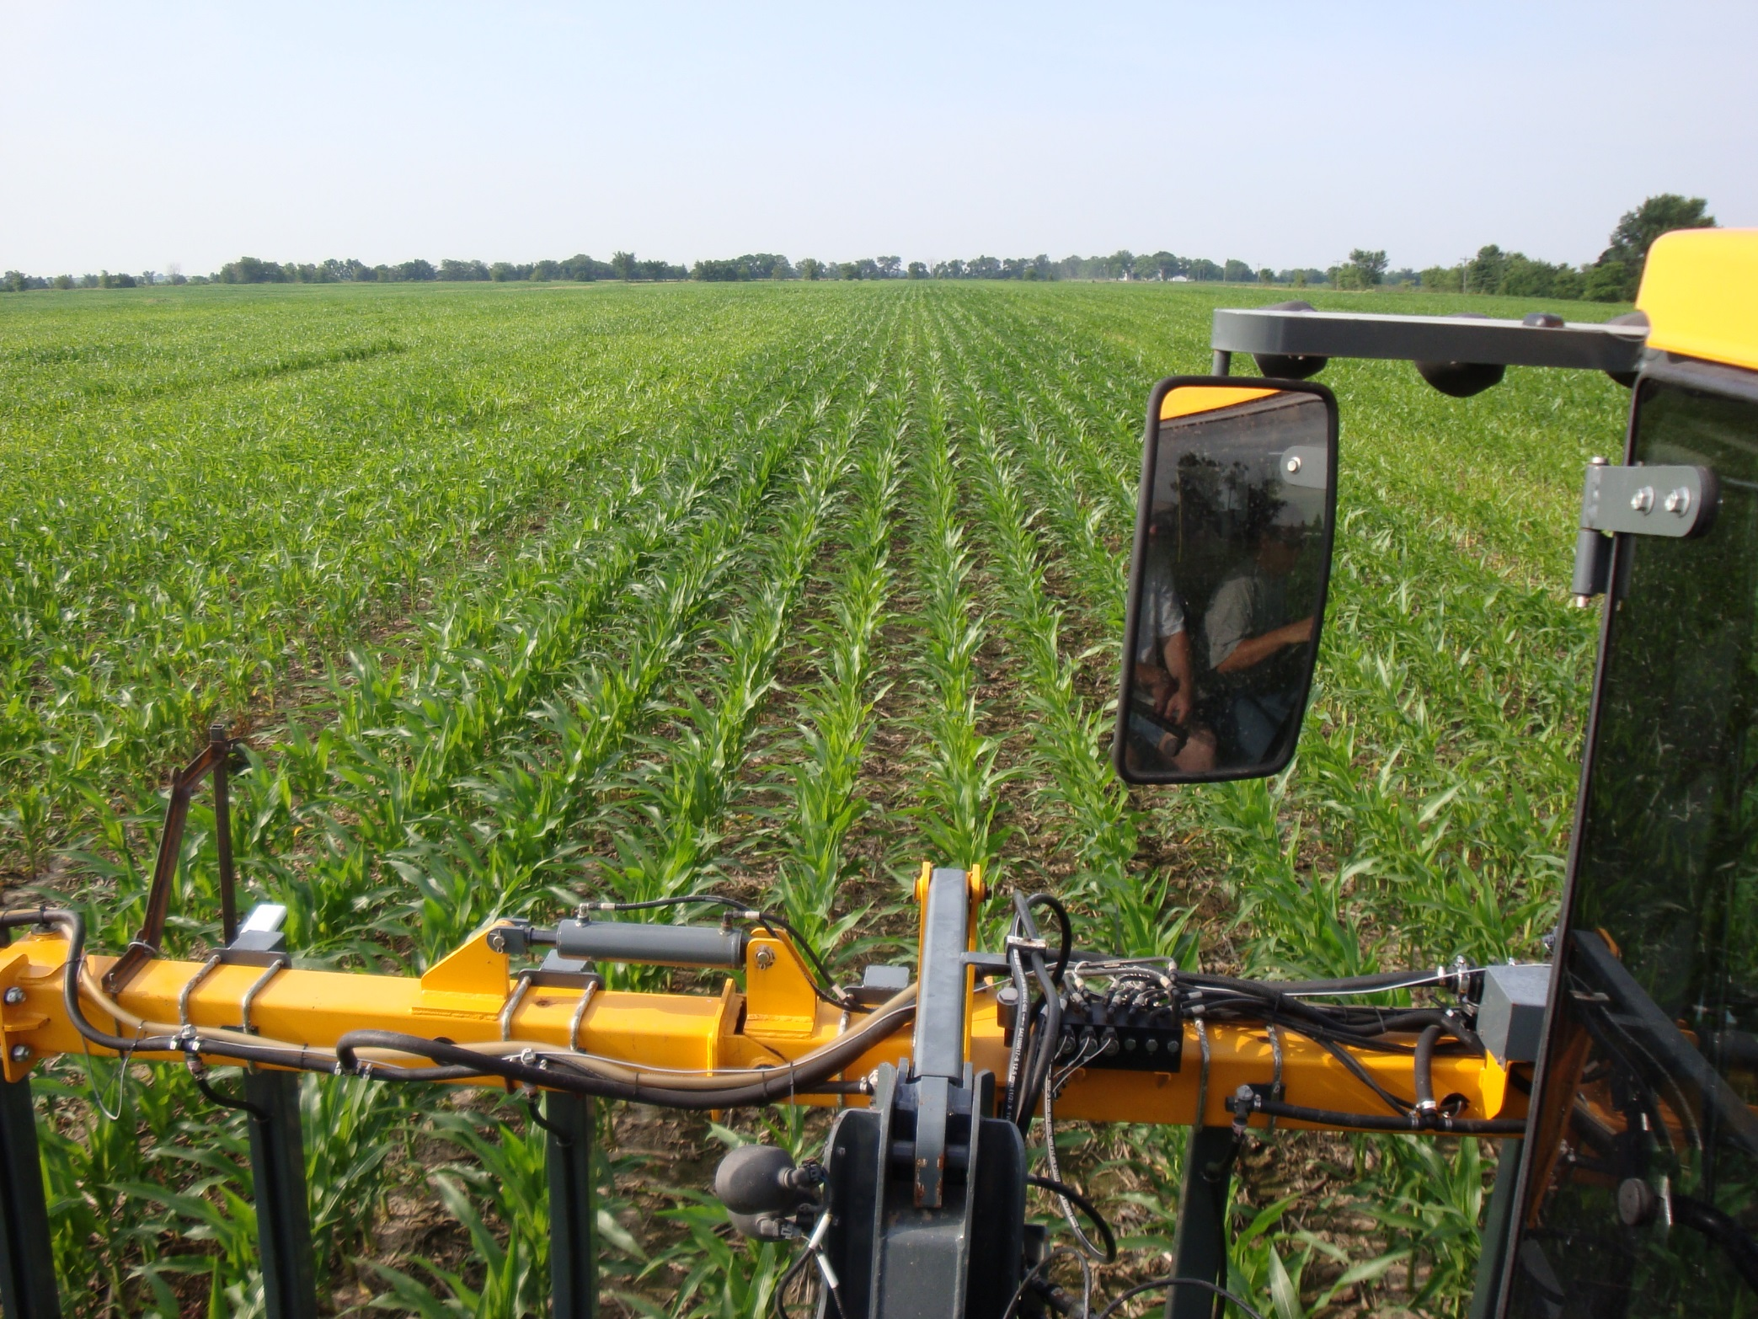
“N-Rich” Strip

Slide 28
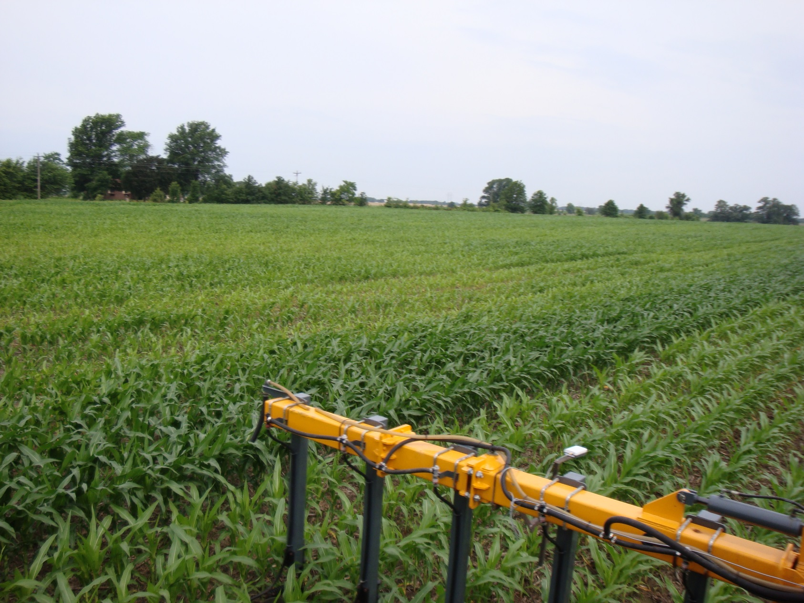
Old fence-row

Slide 29
General “Tips” on the VA Algorithms
What if I don’t have a LOW N reference?
  Use a “virtual” reference
  Drive across the crop
  Note the lowest NDVI value (sustained)
  Multiply by 1.2
  Enter that as “low” REF
  UNDERSTAND that what you just did was ASSUME that the low NDVI values were due to N deficiency

Slide 30
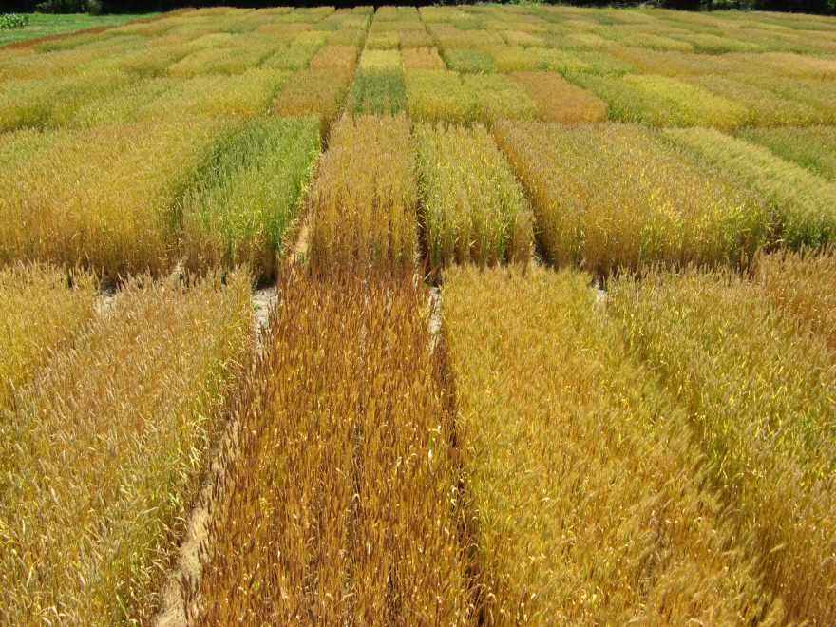
General “Tips” on the VA Algorithms
Can I use the value from a high N reference from a neighboring field or from a different hybrid / variety?
  Absolutely NOT!

Slide 31
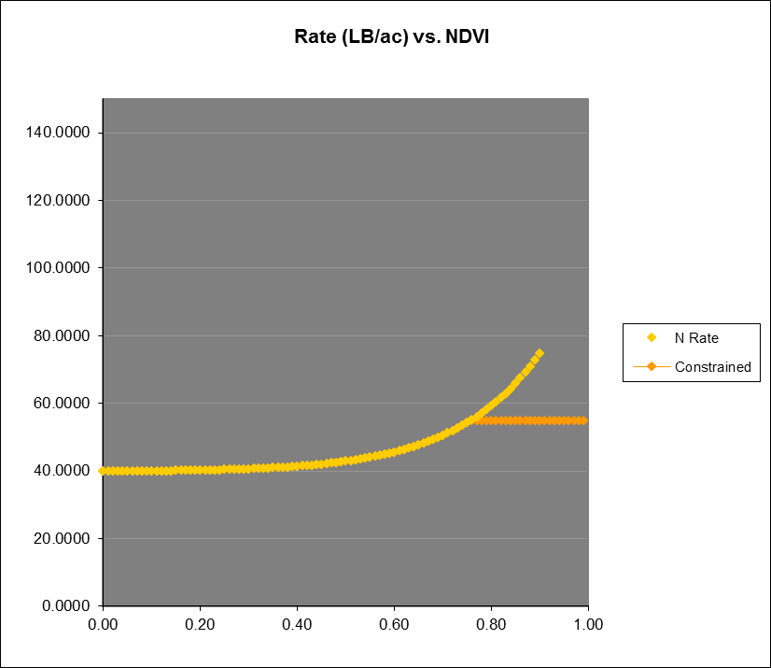
“Tips” on the VA Wheat Algorithm
Very low “range” in N rate applied
  Low RI?
  Early in spring?
  High GS 25 N?
  Uniform stand?
  Low yield potential?

Slide 32
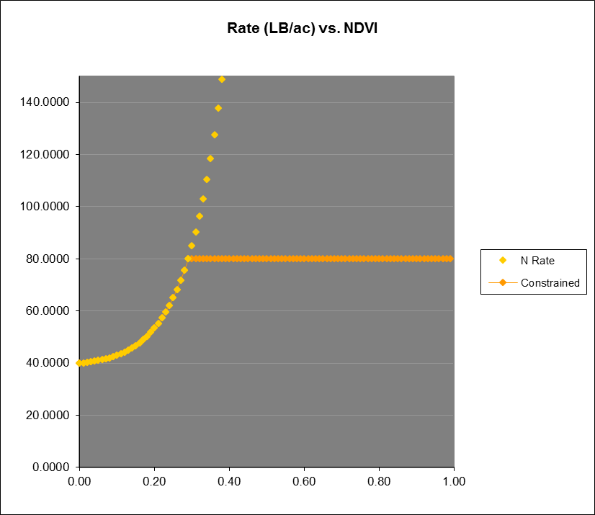
“Tips” on the VA Wheat Algorithm
Very quick to max rate
  High RI?
  Early in spring?
  Low GS 25 N?
  Uniform stand?
  Overly optimistic yield potential?

Slide 33
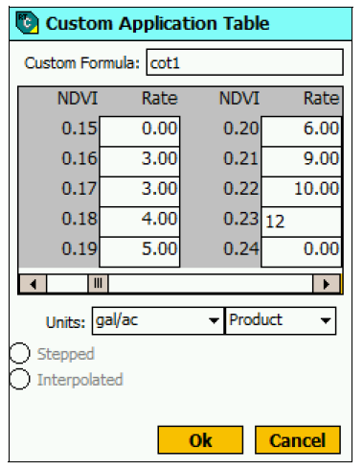
“Tips” on the VA Wheat Algorithm
The range of rates predicted by the system don’t match the number I had in mind.
  Ask yourself why
  Seek corroboration
  Tweak the inputs
  Build your own?

Slide 34
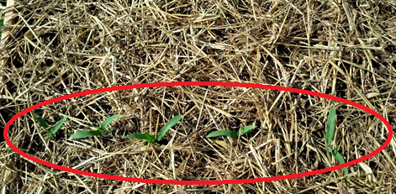
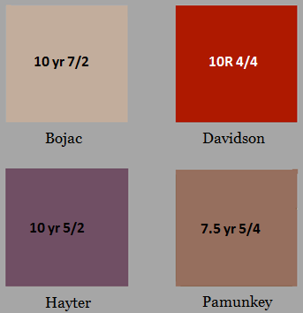
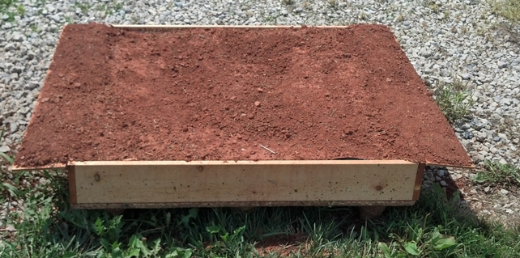
Controlled Experiment
Conducted in Blacksburg
8 wooden boxes were built and filled with 1 of 4 soil type

Slide 35
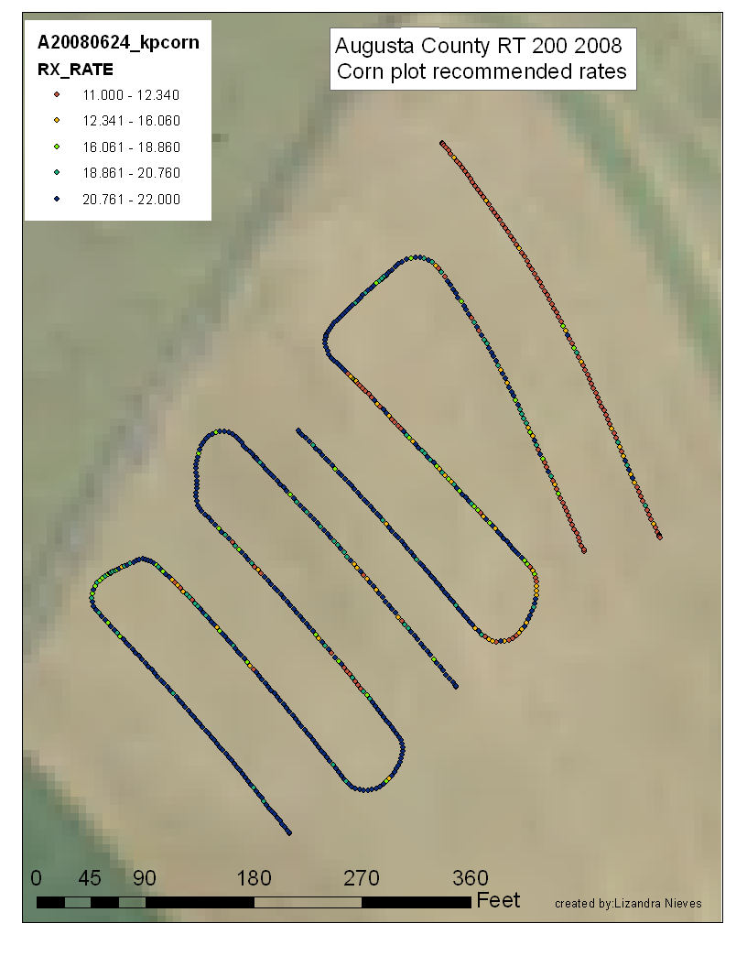
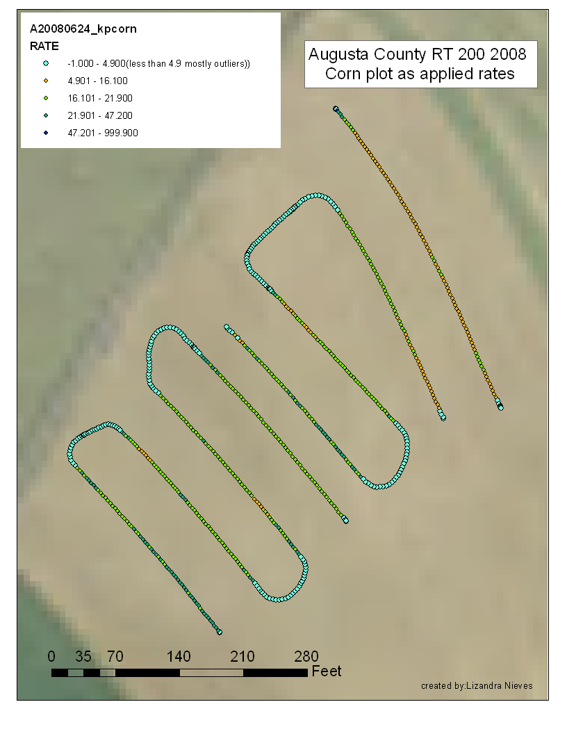
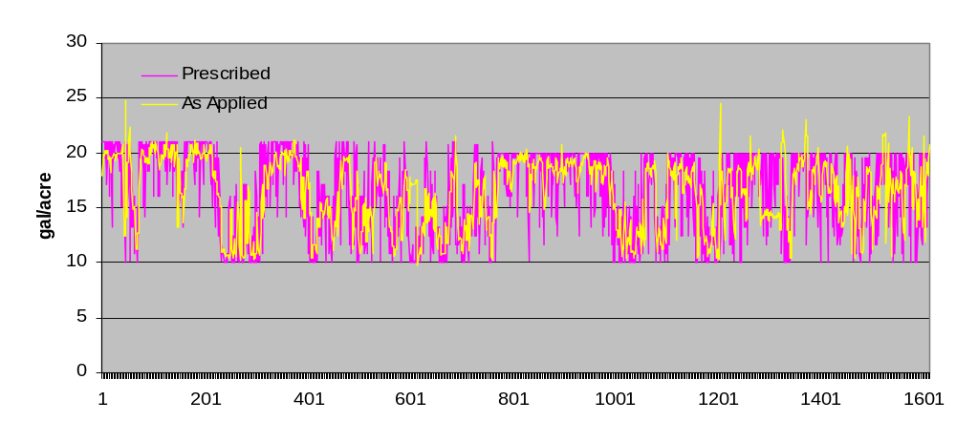
RX vs. Applied Rates
Notes:
55% of points are within 2 gal of prescribed rate
88% of points are within 5 gal of prescribed rate

Slide 36
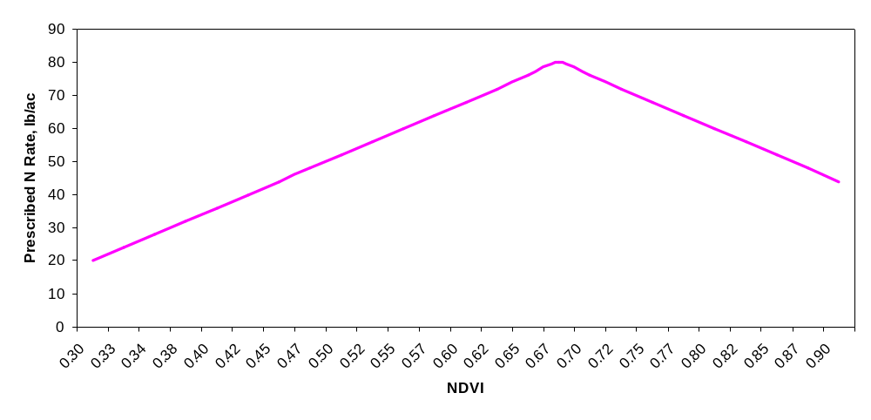
Sensor Summary
Requires that you are already comfortable with sidedressing the majority of your N
Install N rich strip and N deficient strip in each field
Understand that it’s not always right, but research indicates that it is correct more often than the flat rate you are currently using
There are different sensor technologies, but it’s really the algorithm that matters
Flat Rate

Slide 37
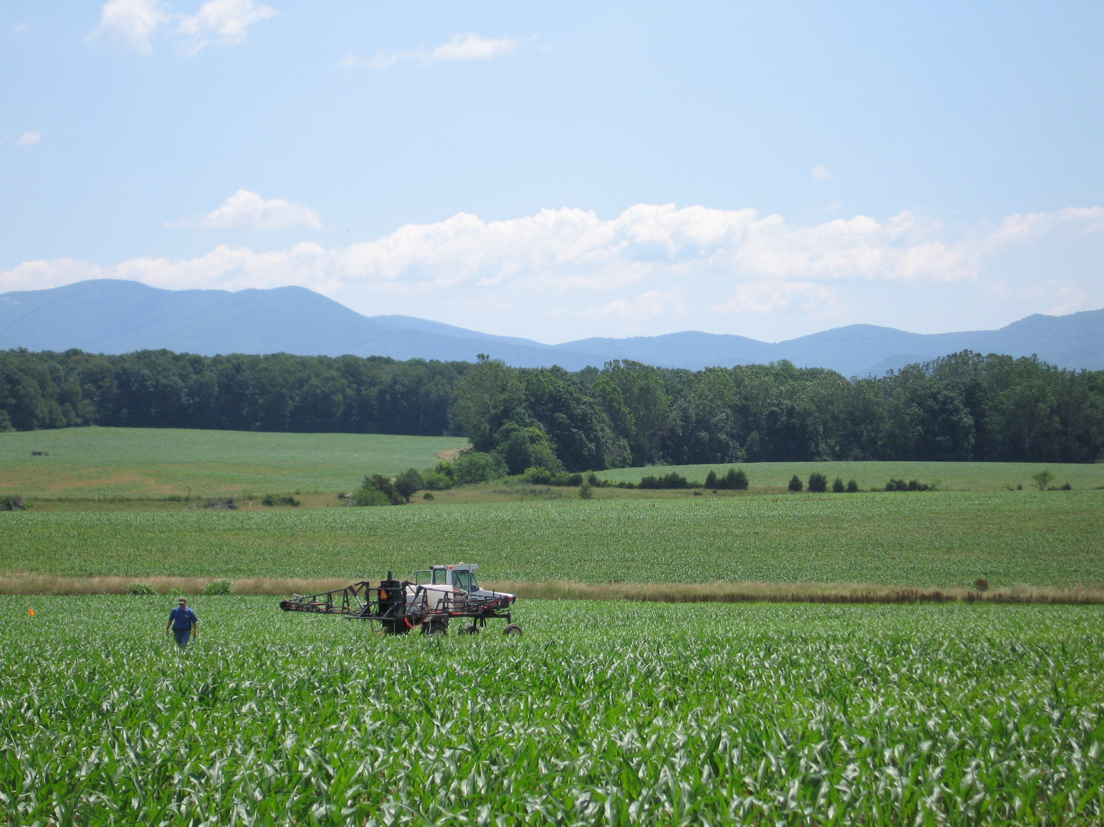
Questions?

